Slide 2
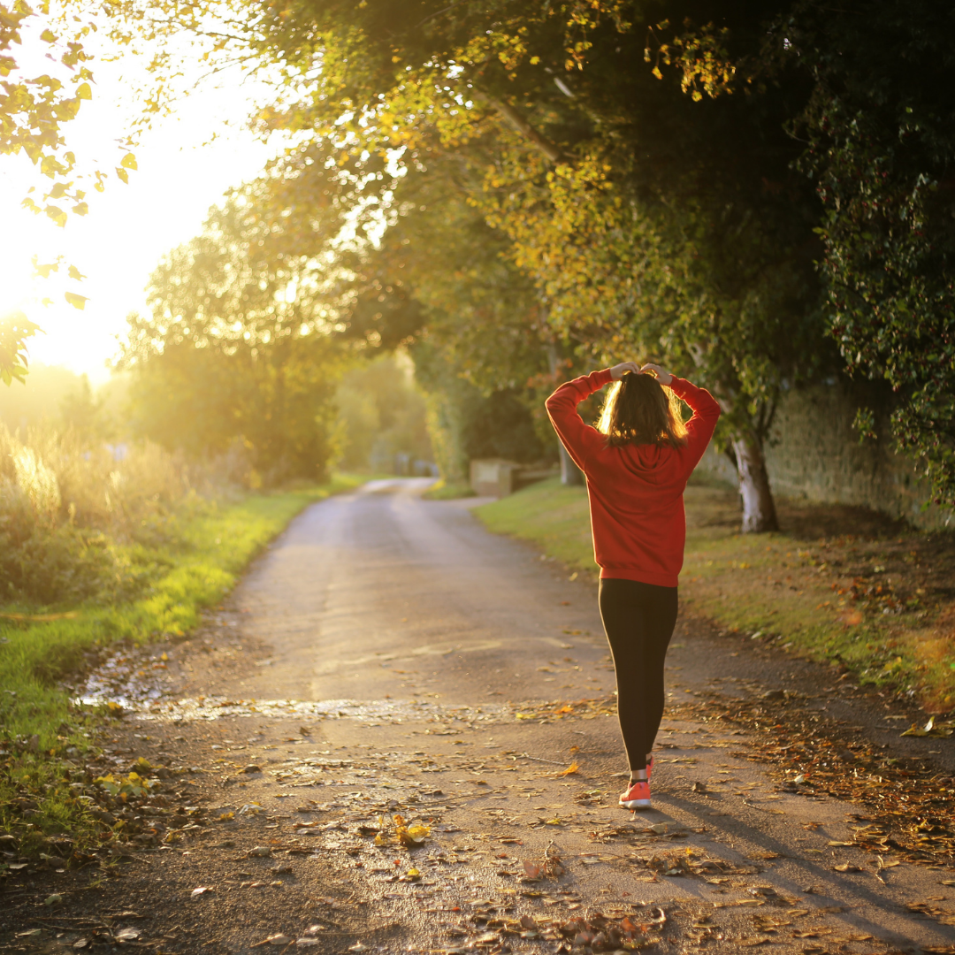
We started
with
just
one
step.

Slide 3
LYMPHEDEMA
ASSOCIATION
OF ONTARIO
Participating
Members,Family
& Friends

Slide 4
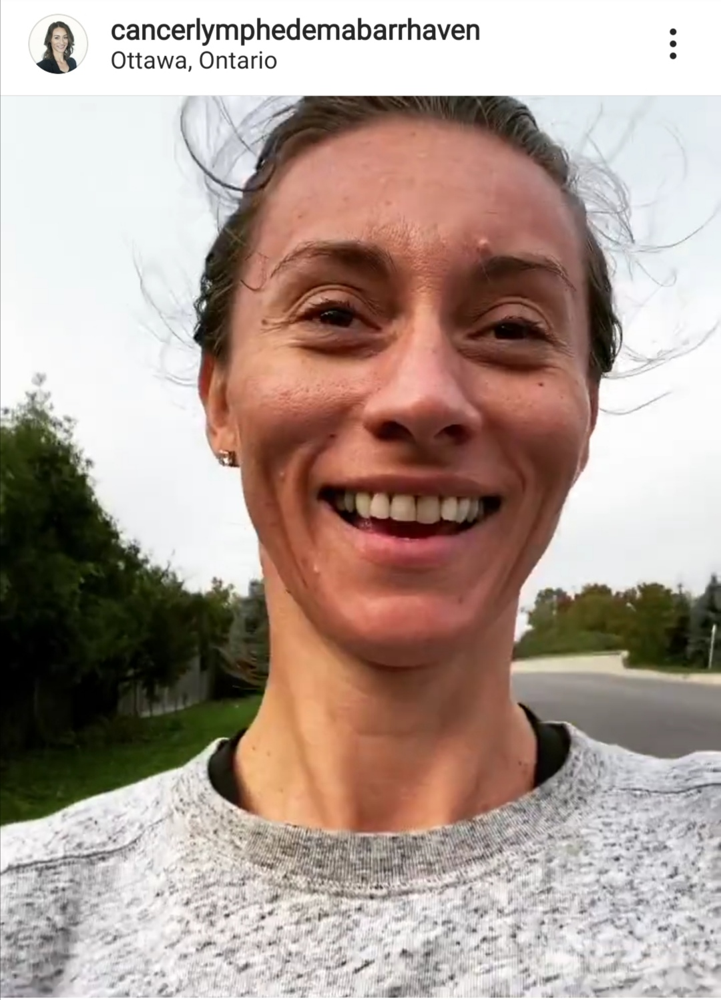

Slide 5
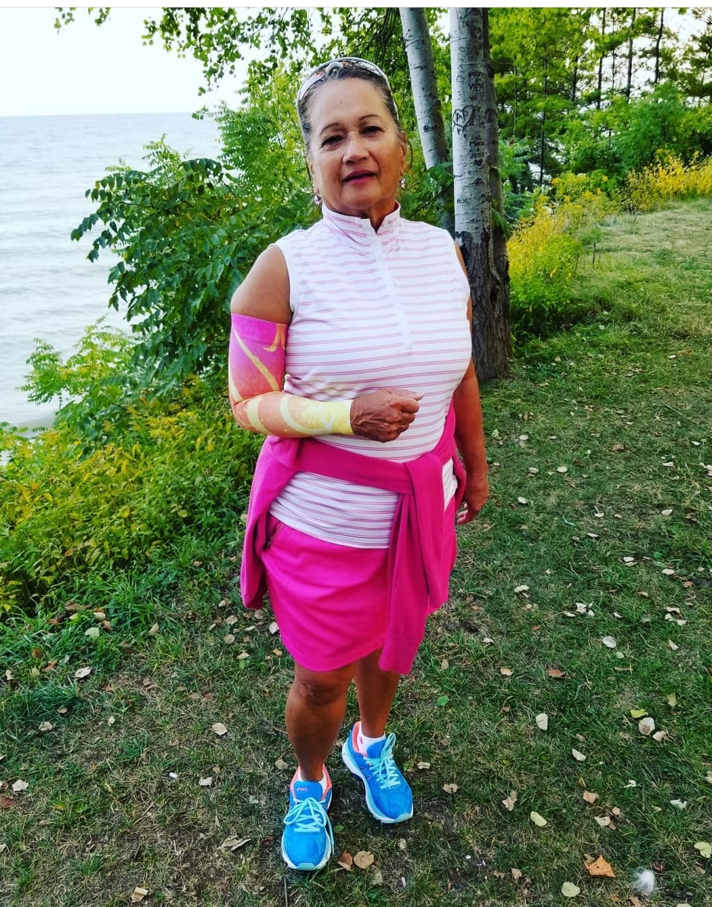
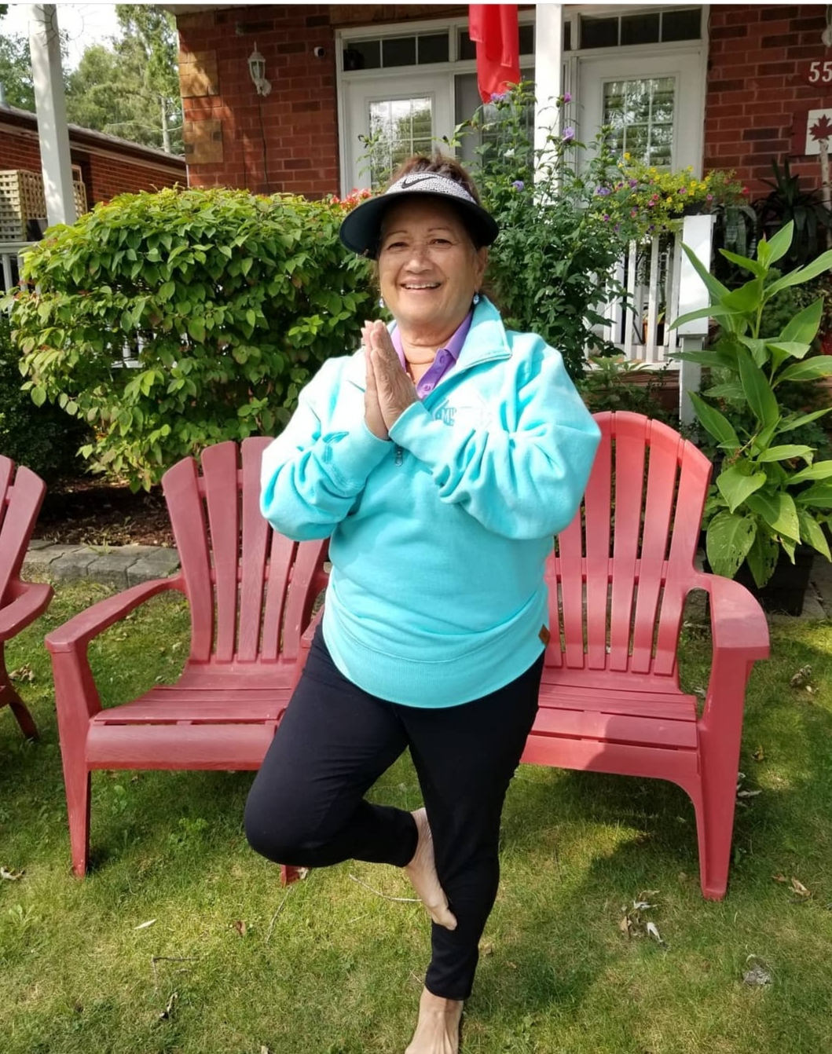
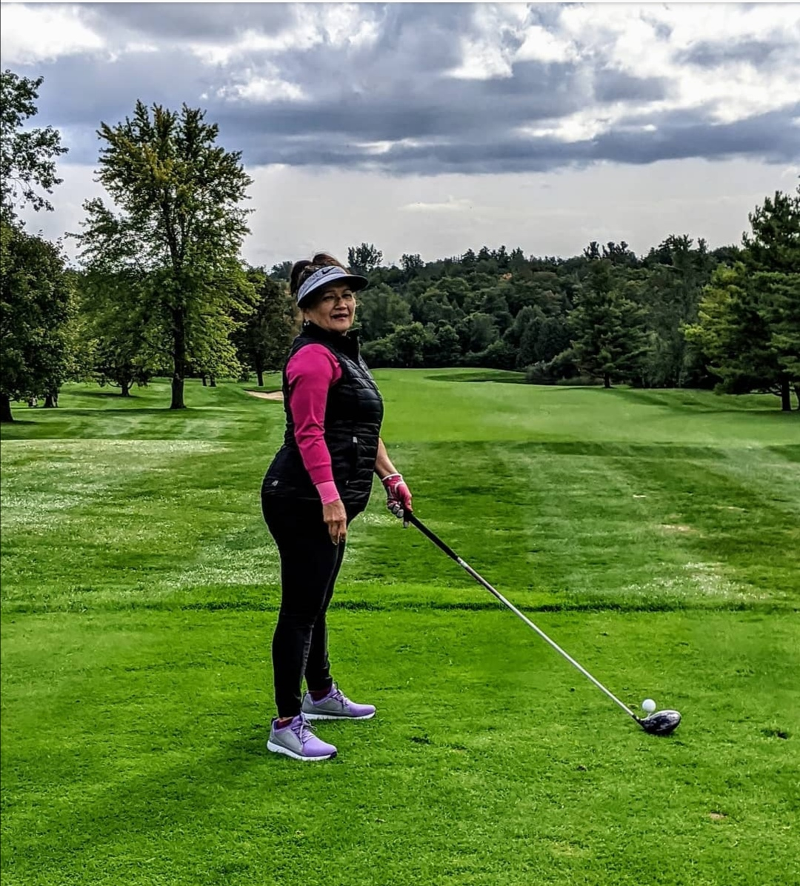

Slide 6
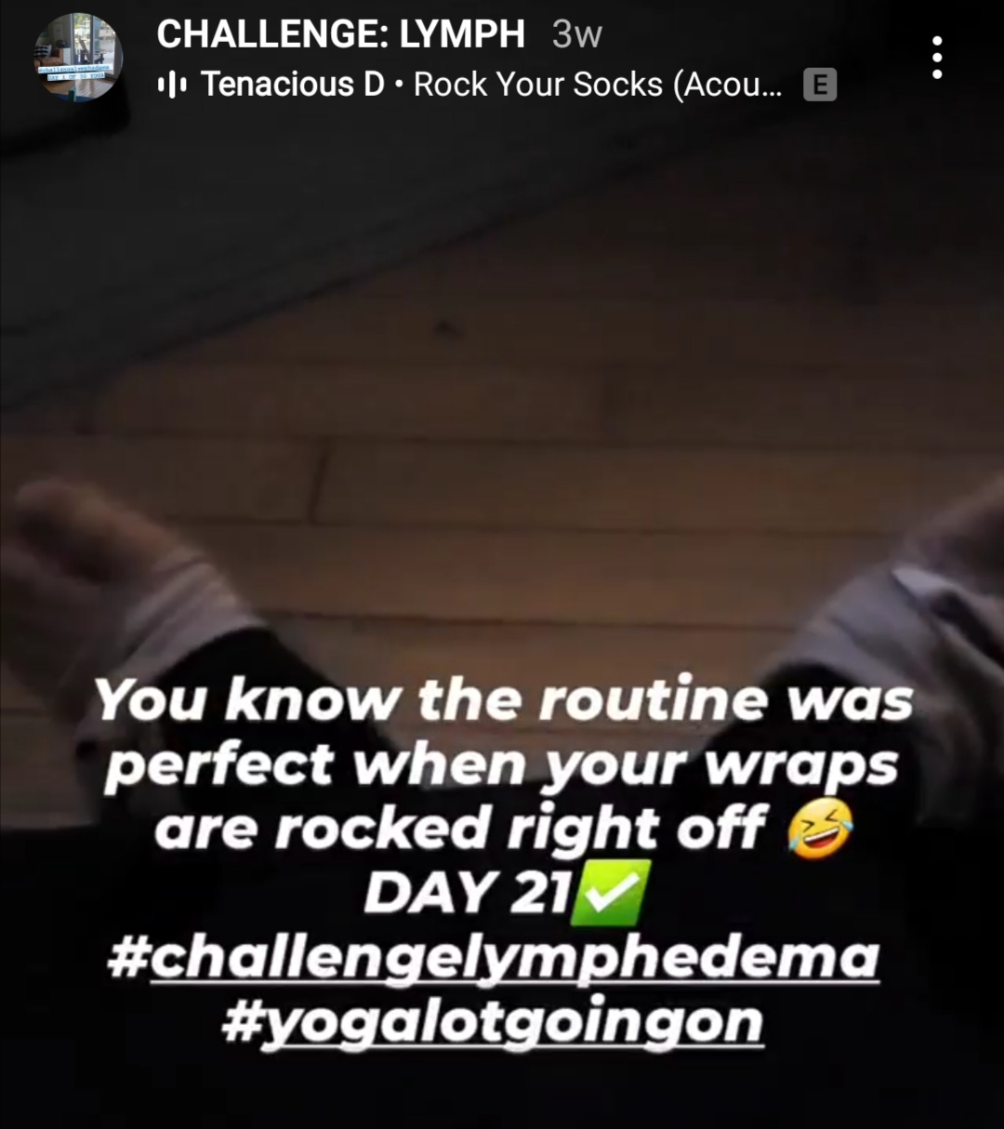
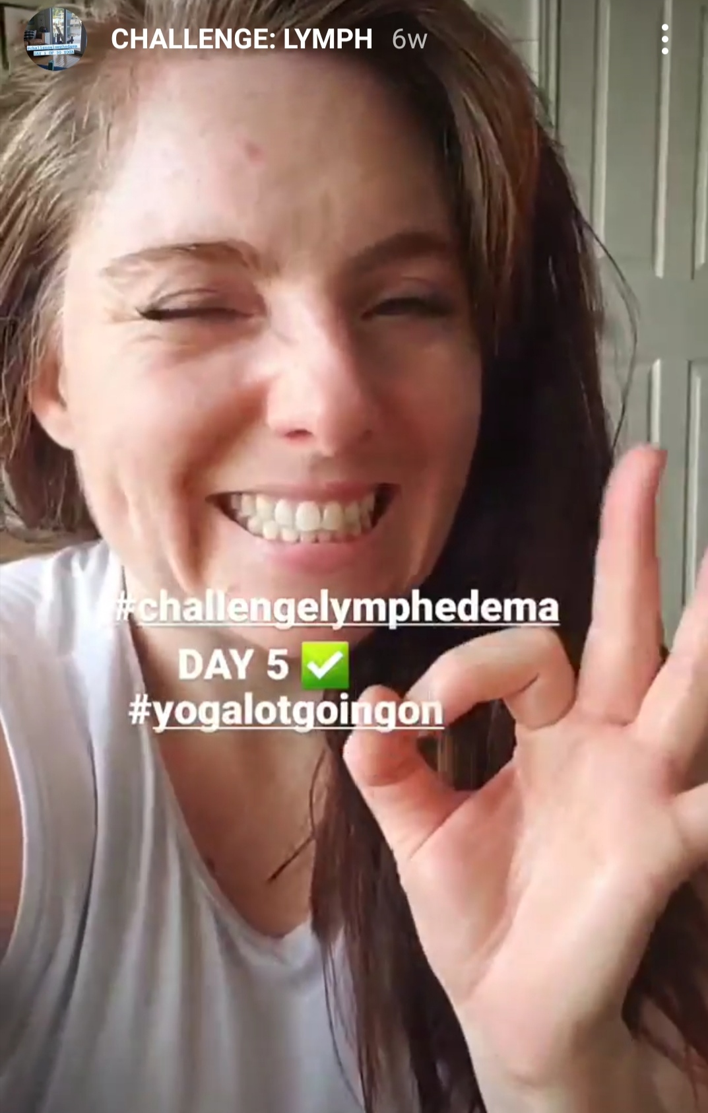
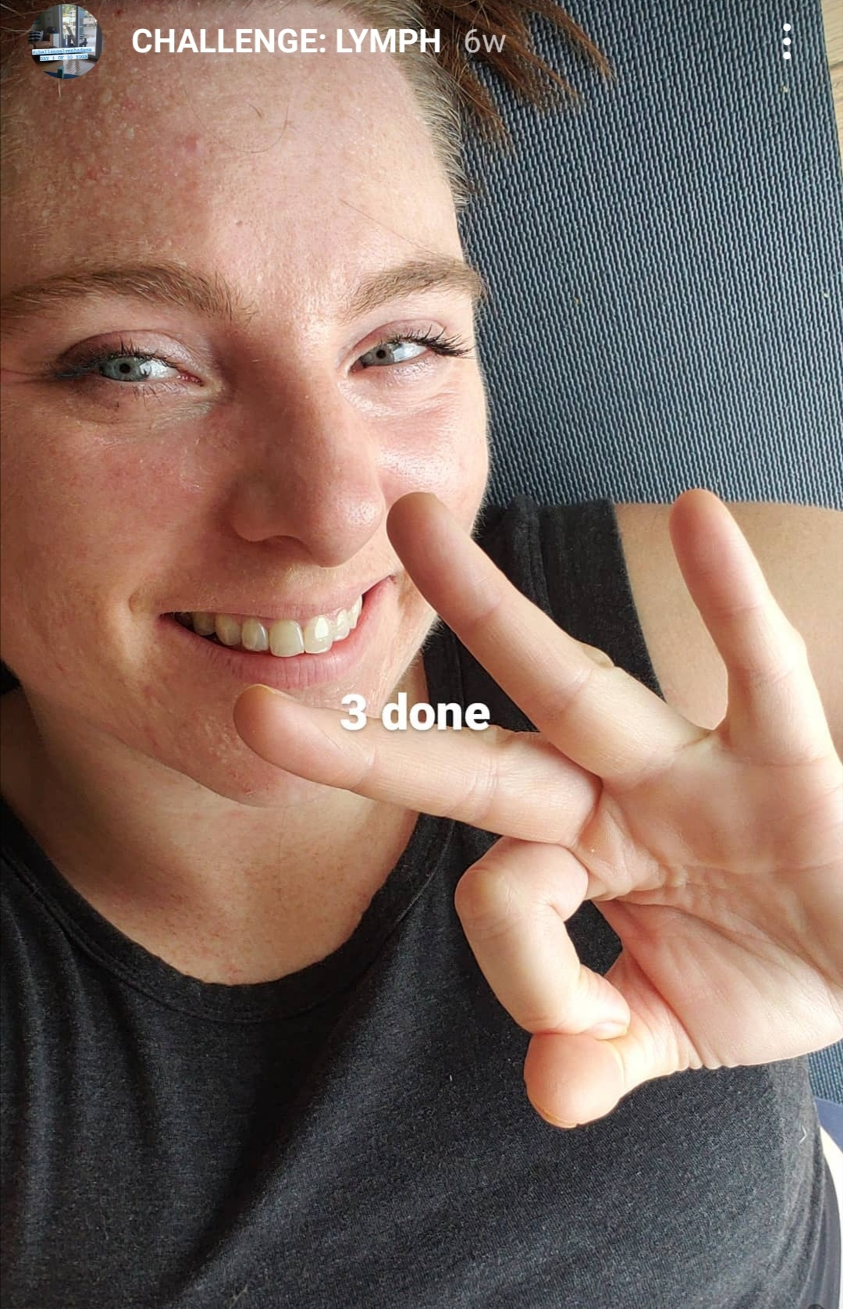
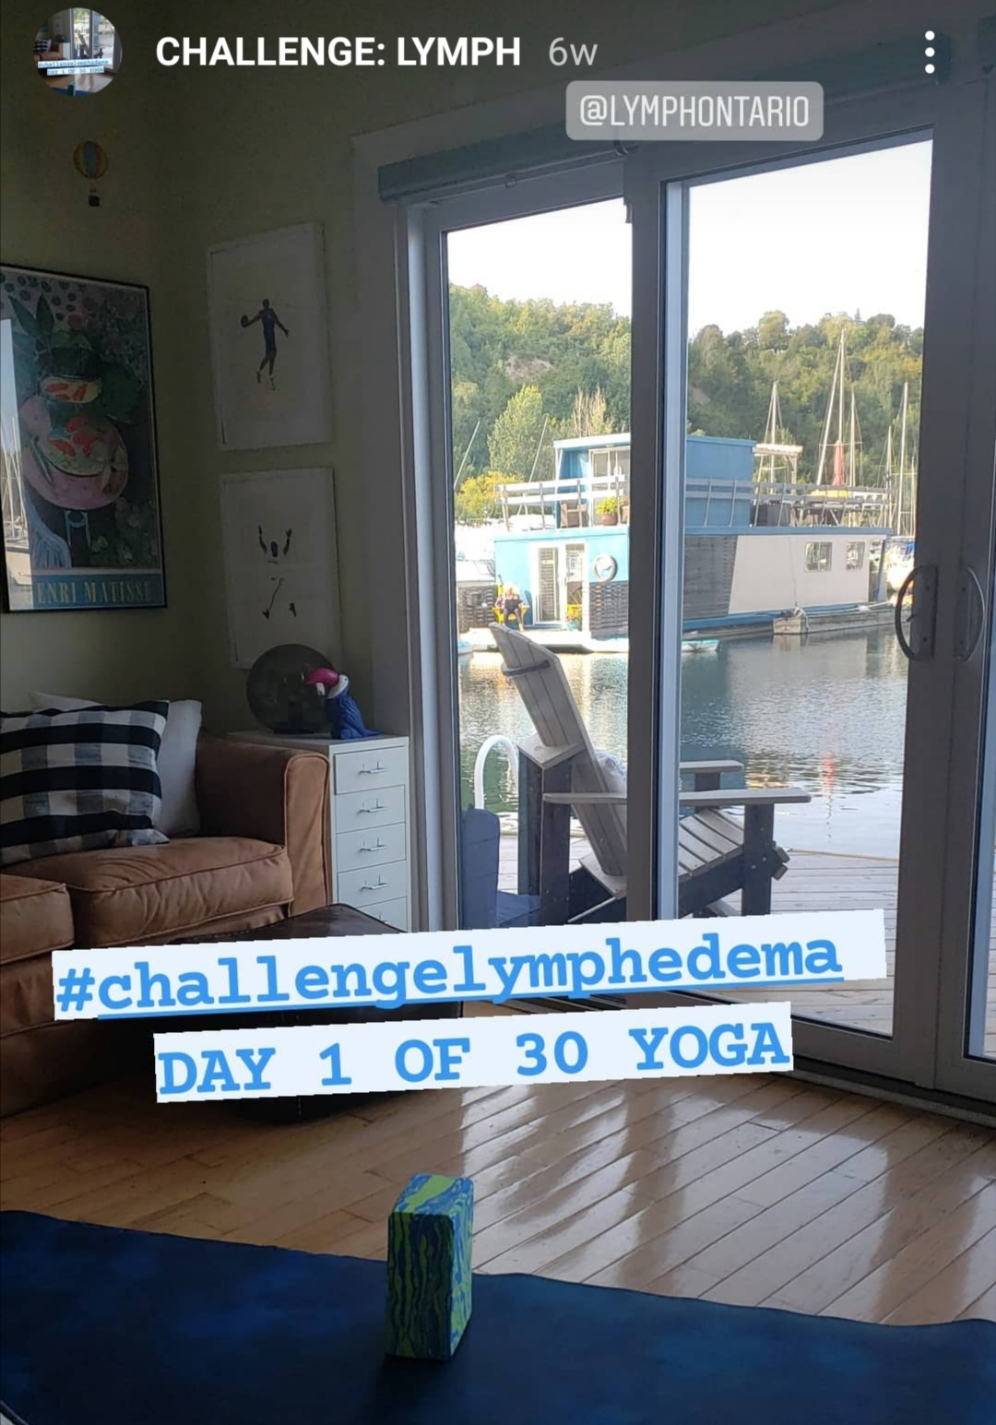
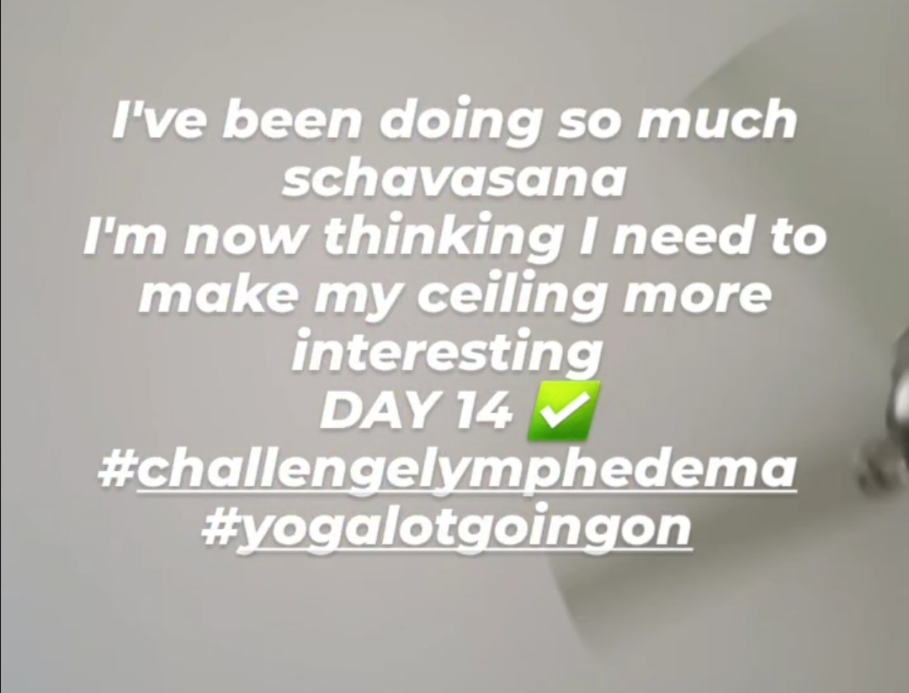

Slide 7
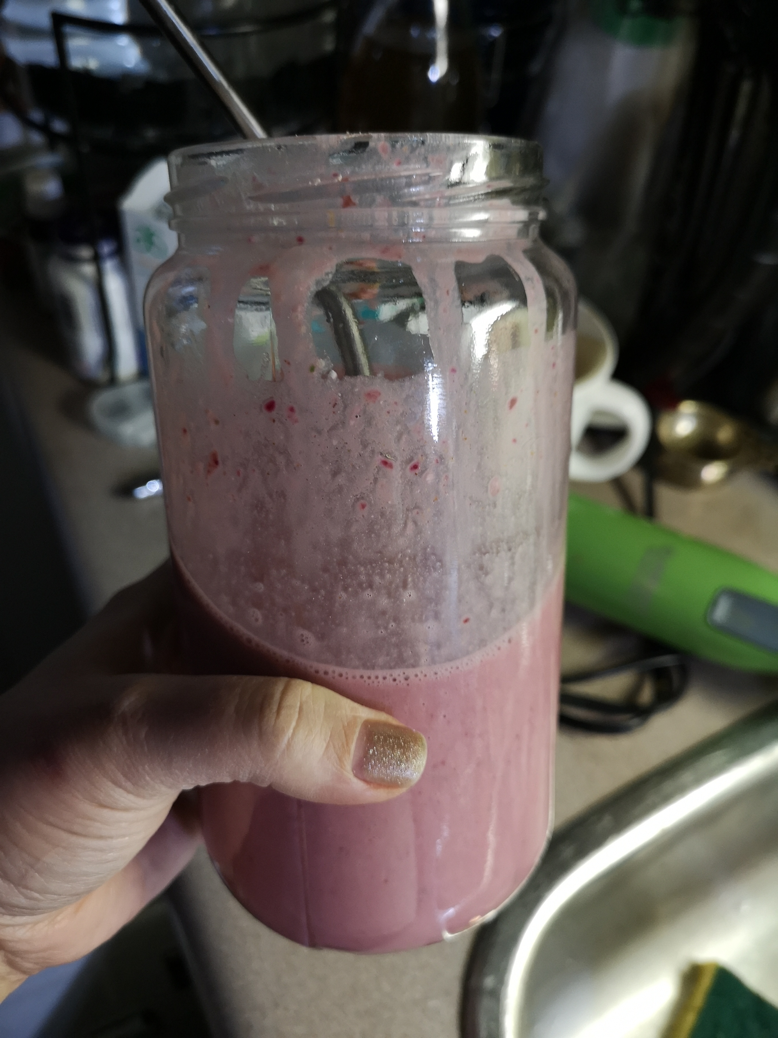
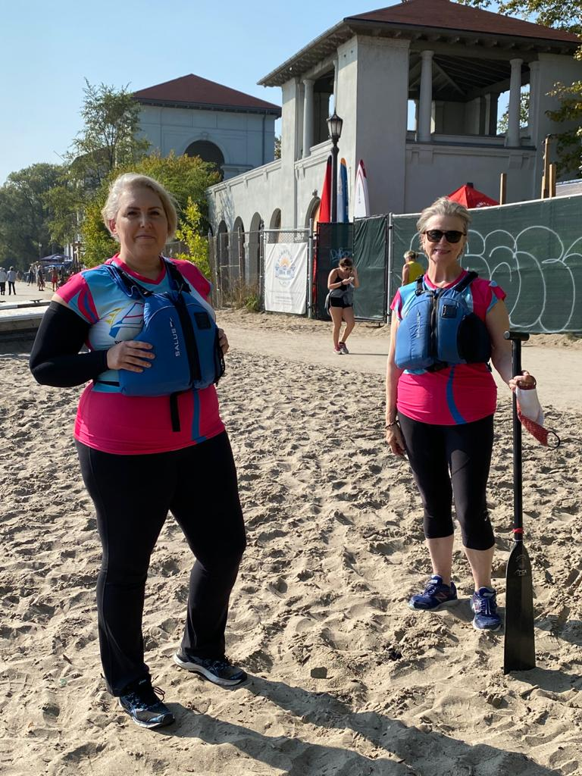
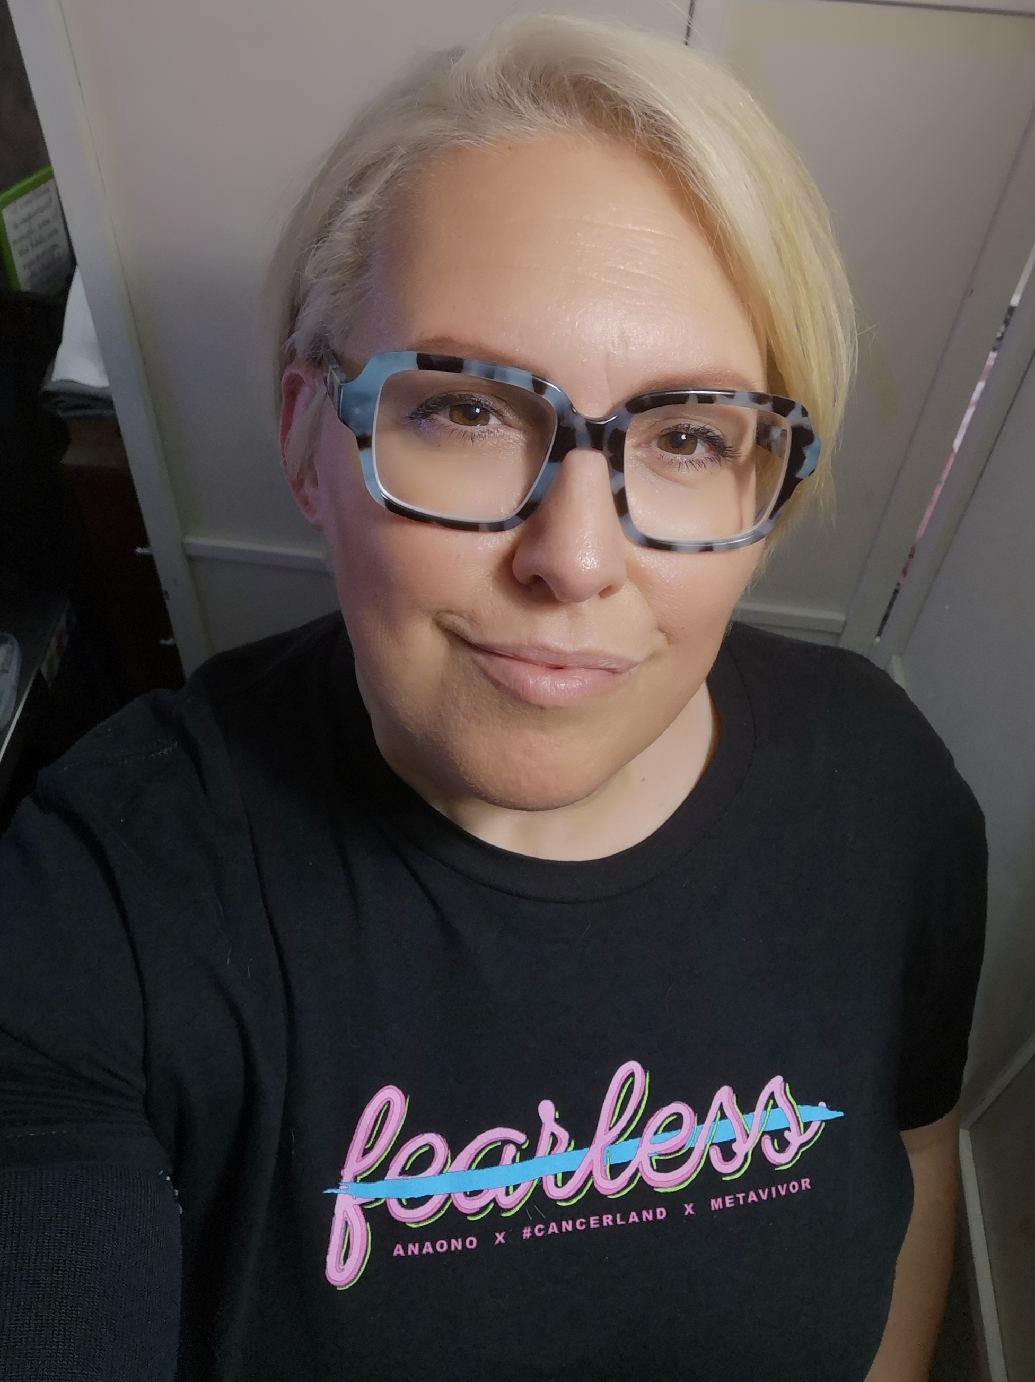
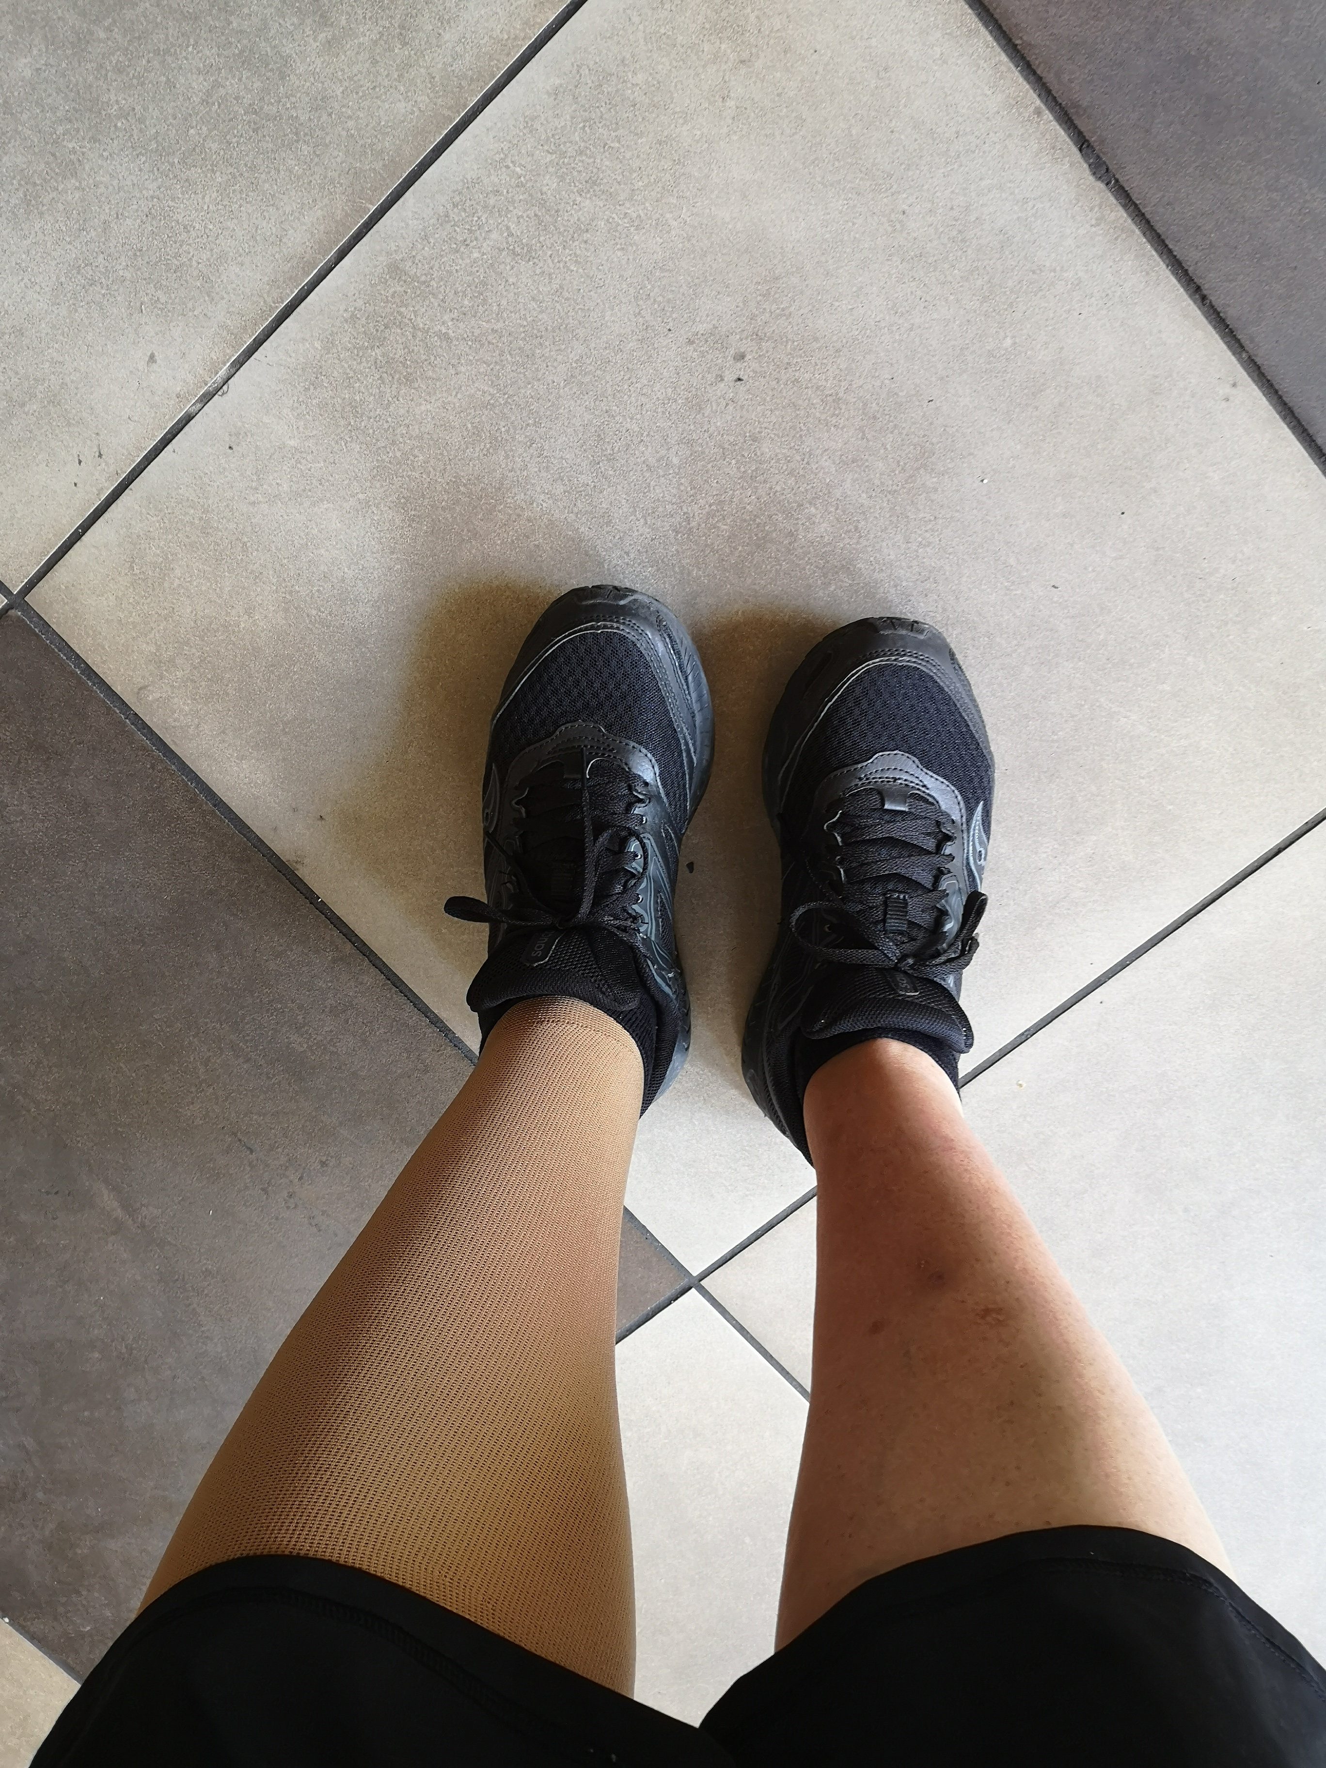

Slide 8
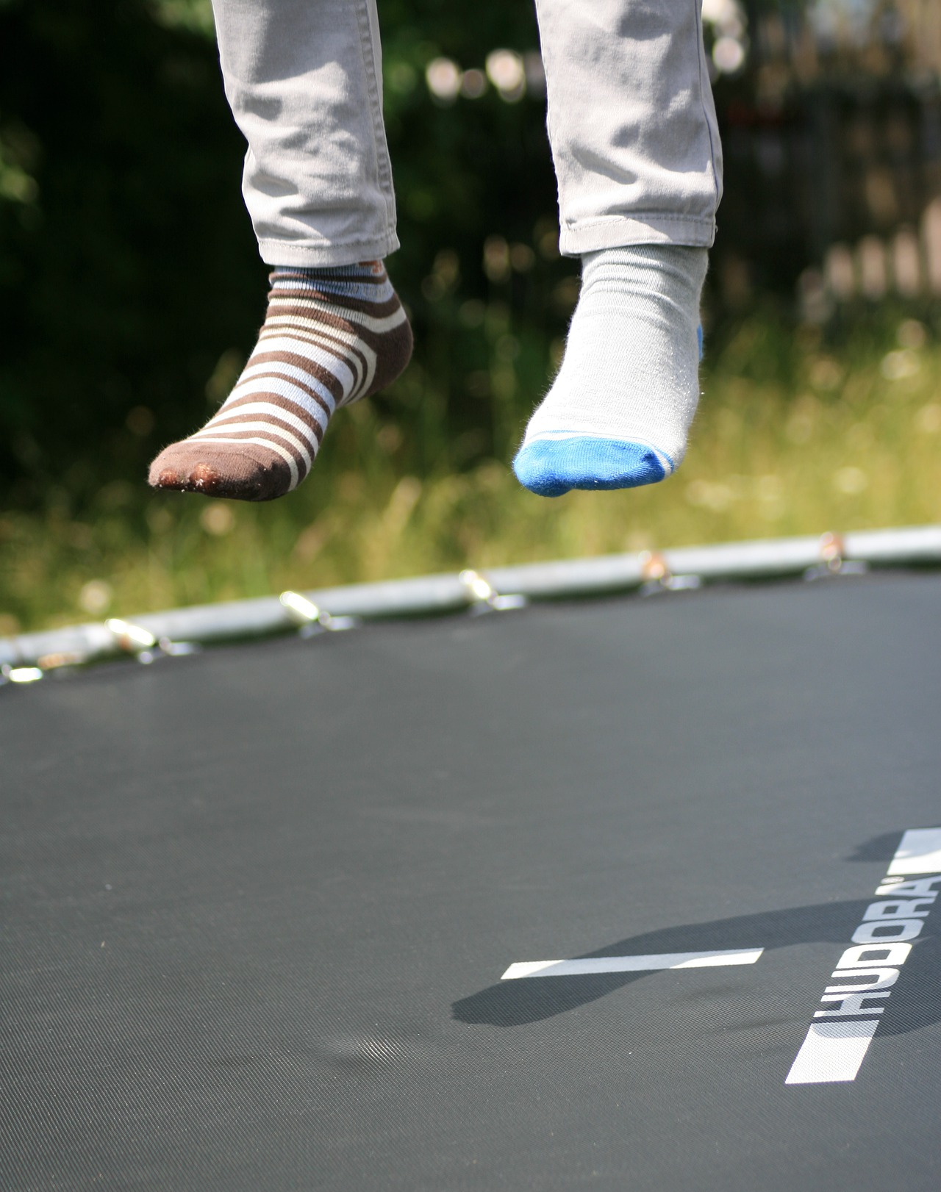
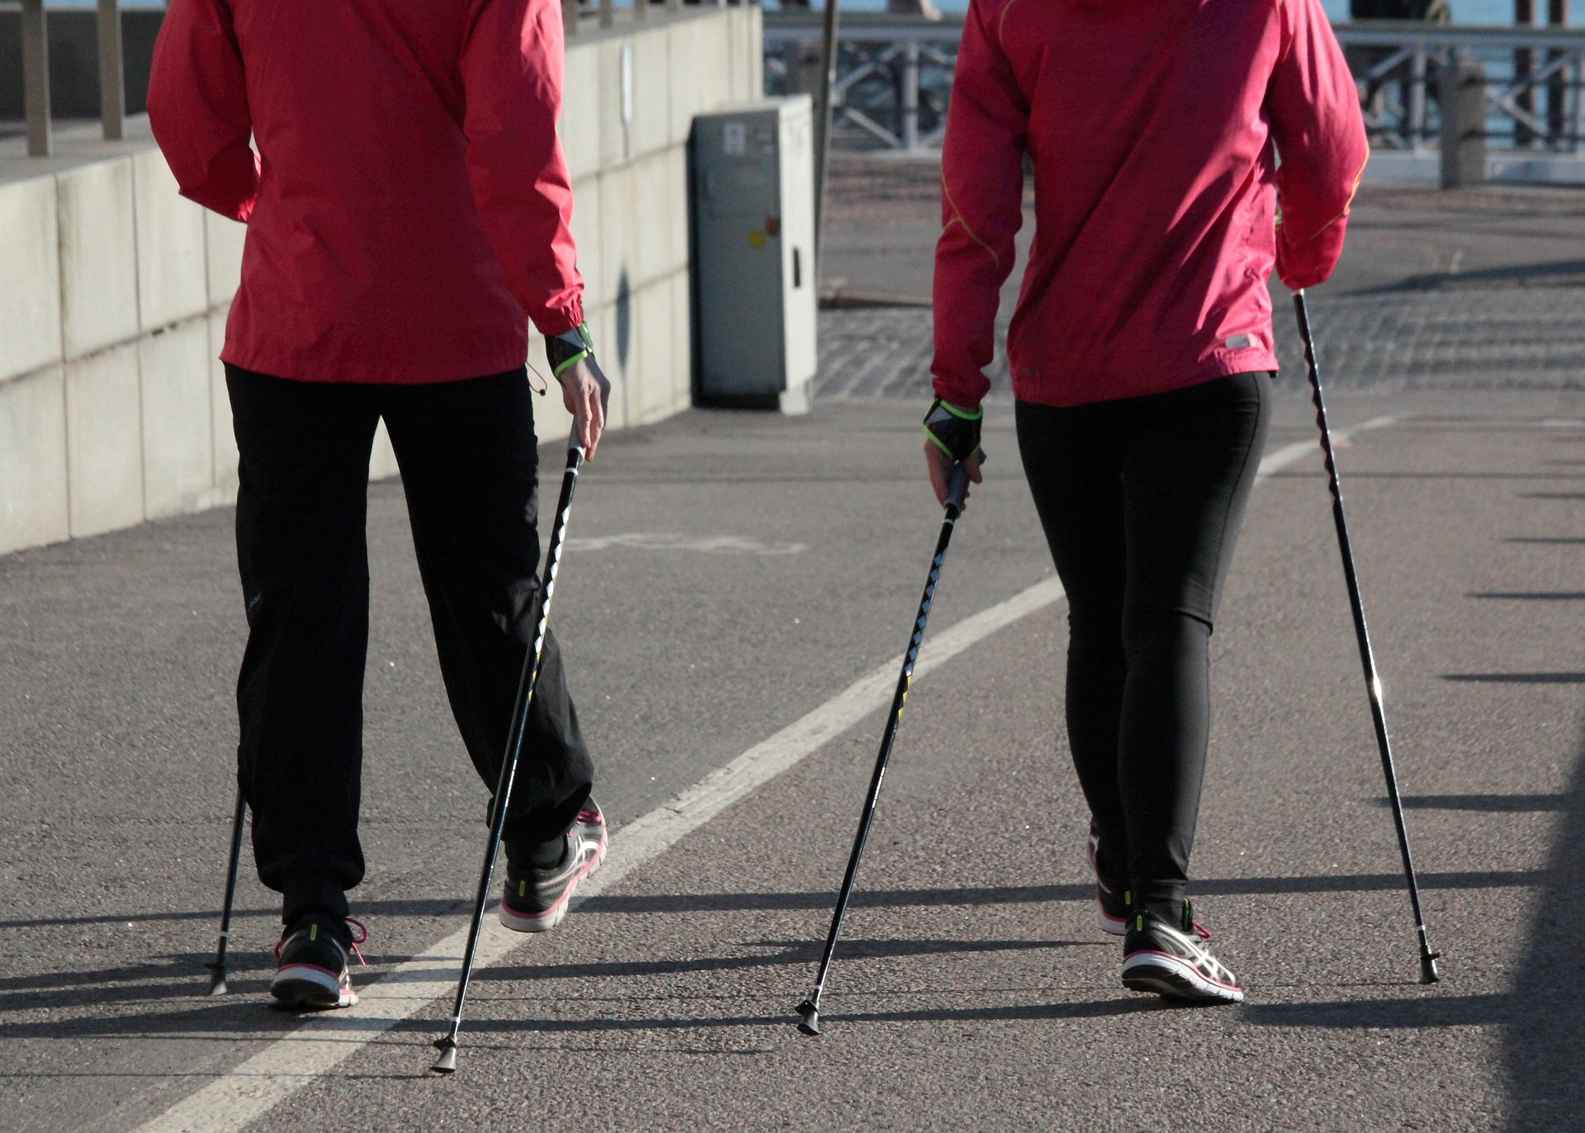
Movement of all types kept us going through our 30 days of our Challenge:Lymphedema

Slide 9
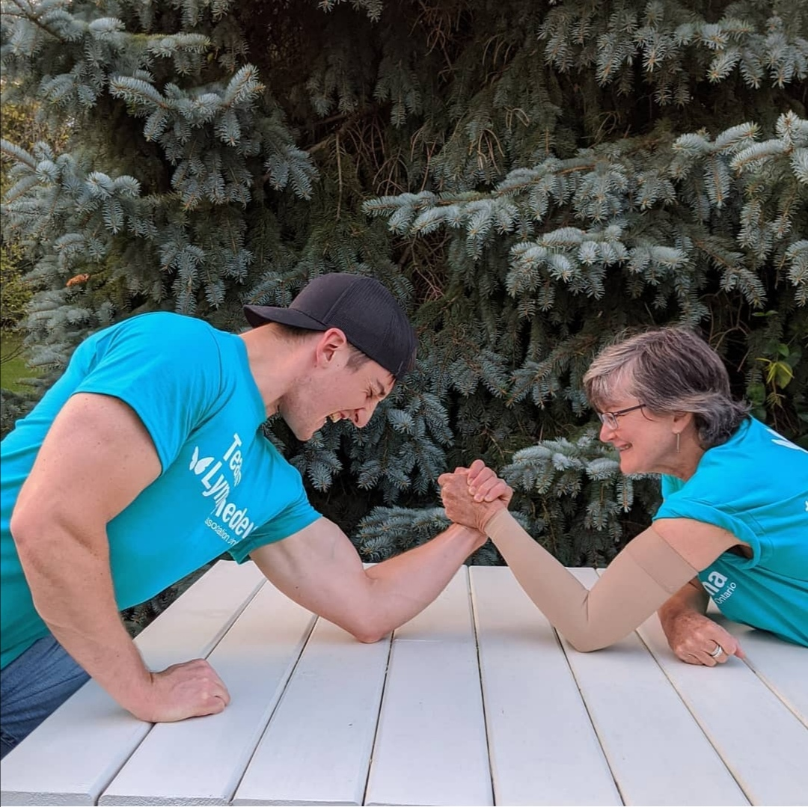

Slide 10
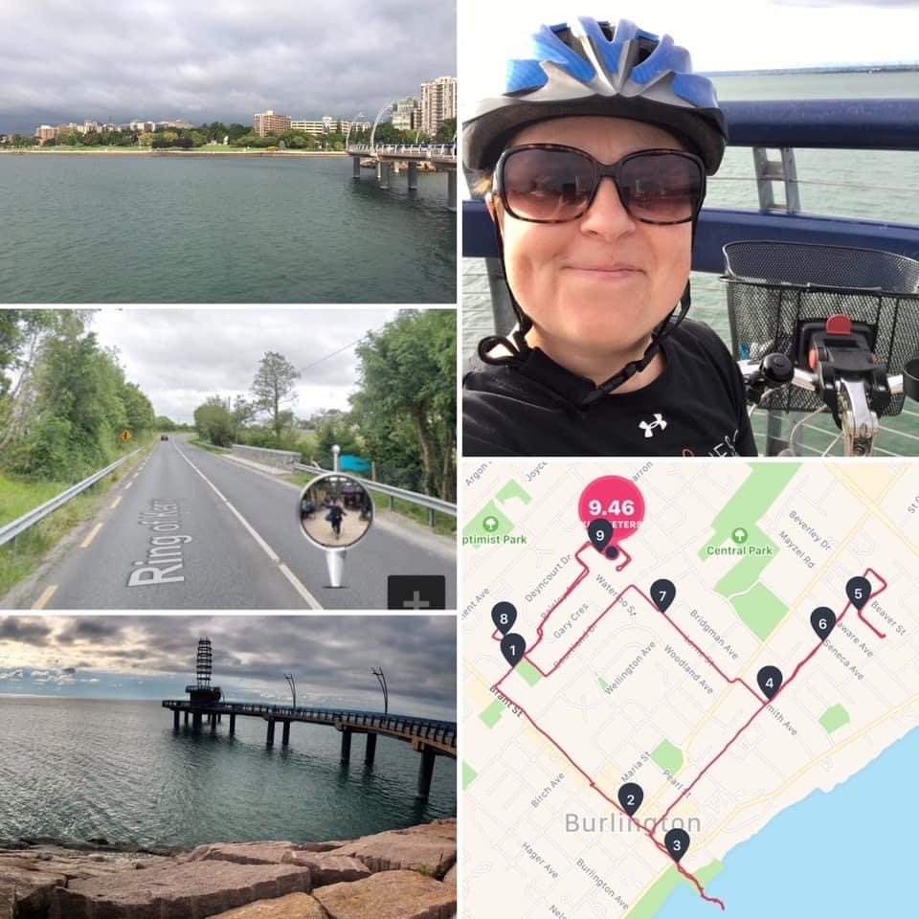

Slide 11
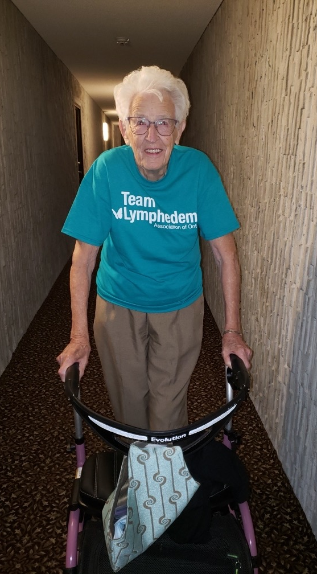
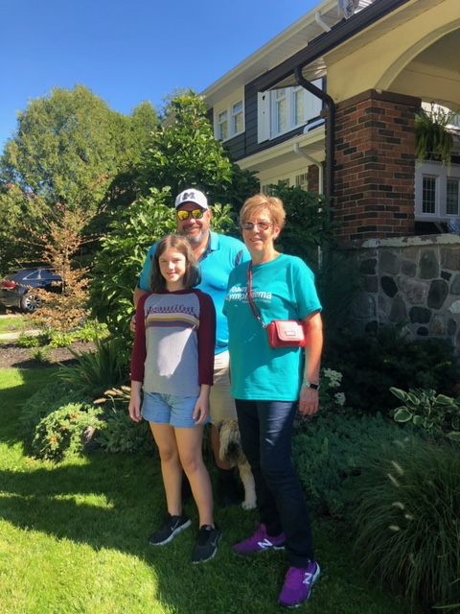
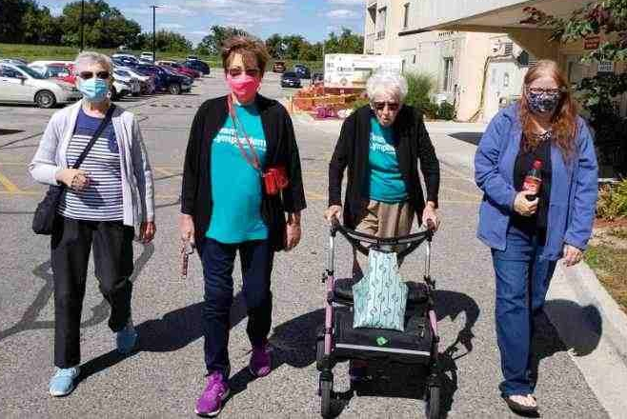
*Our oldest
Participant!

Slide 12
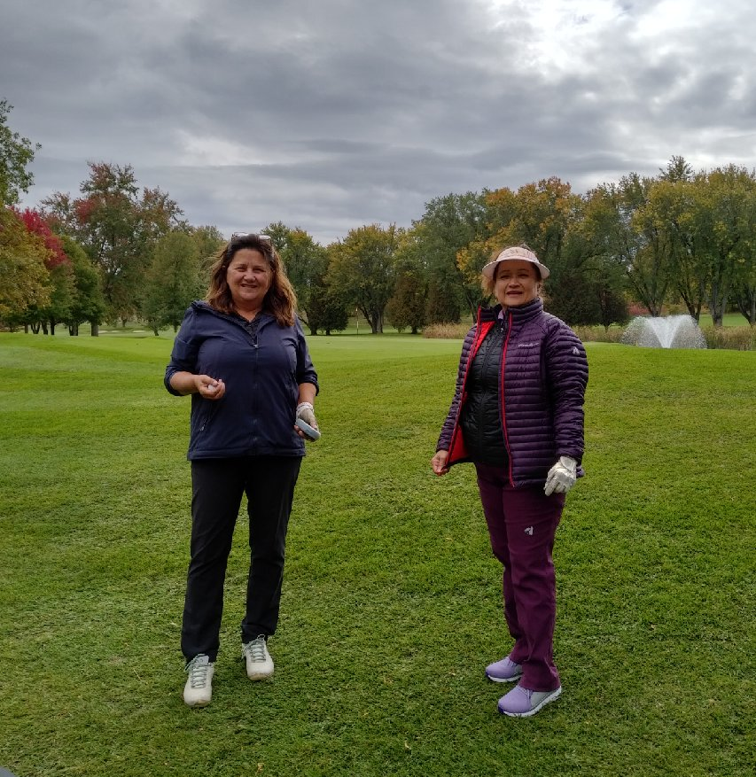
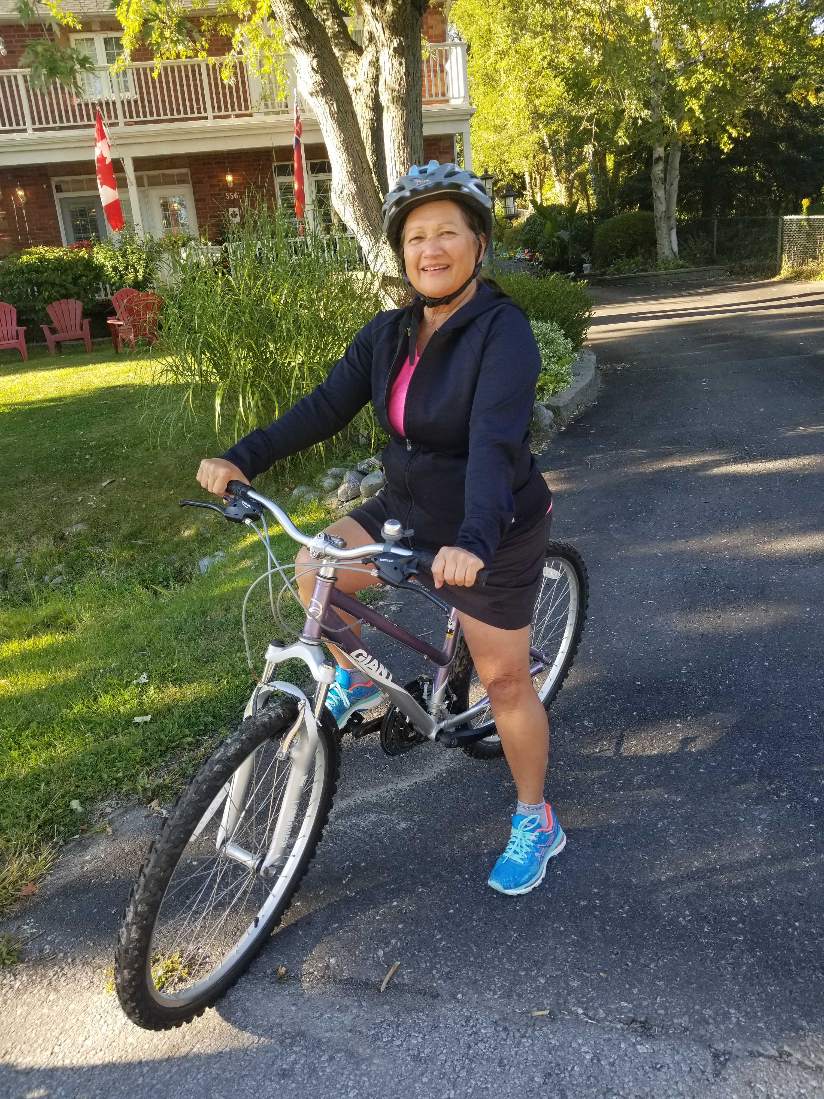
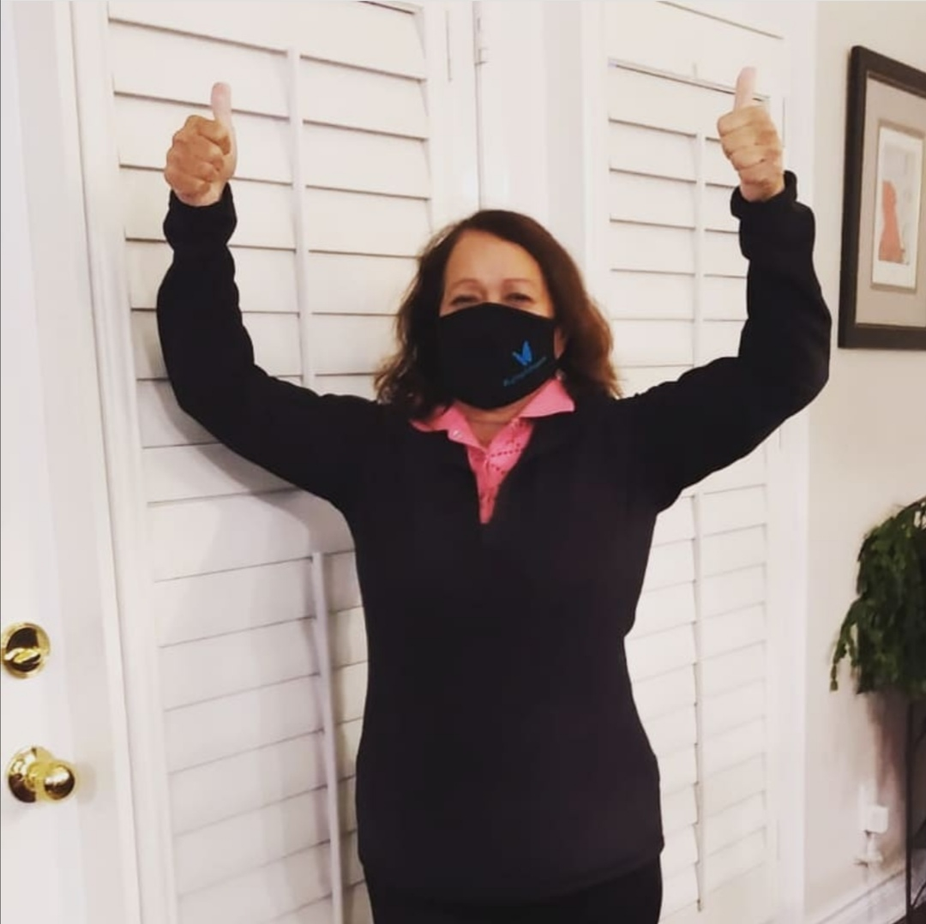
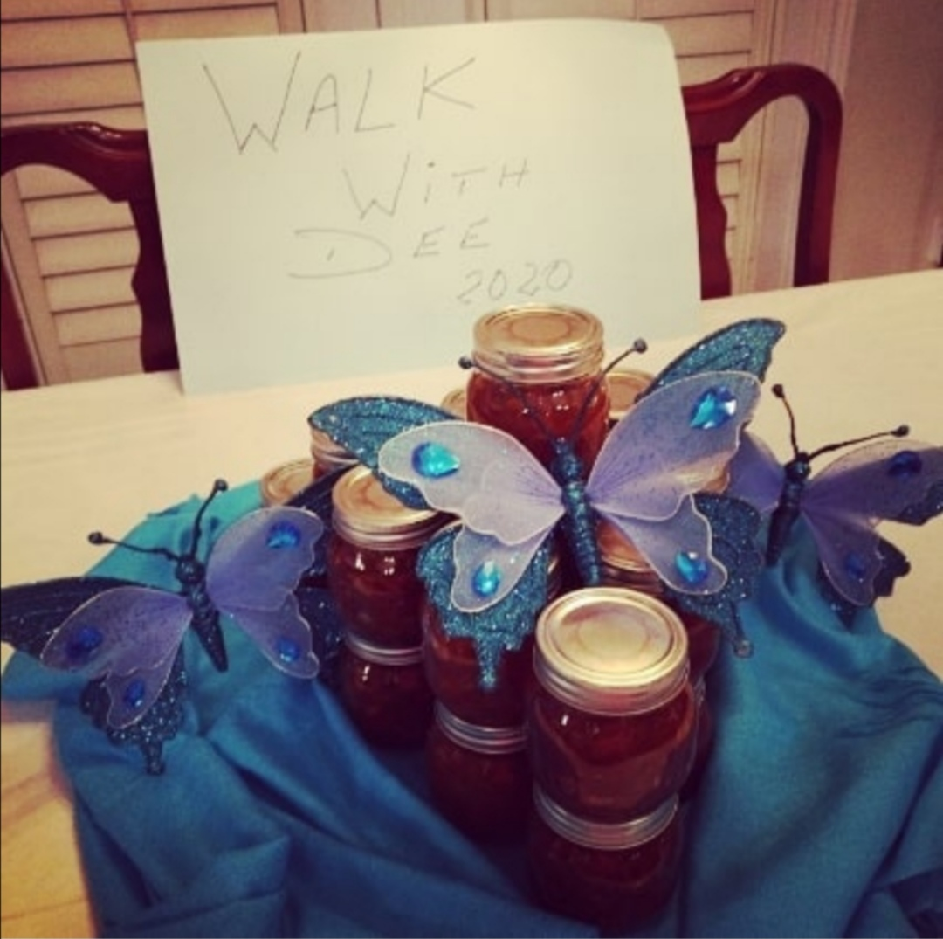

Slide 13
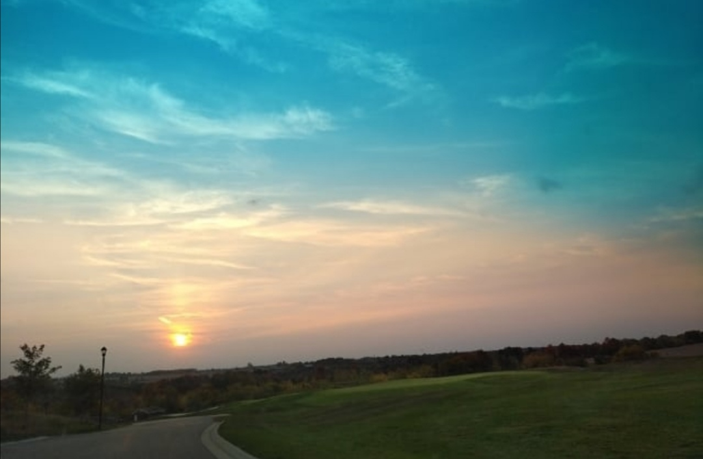
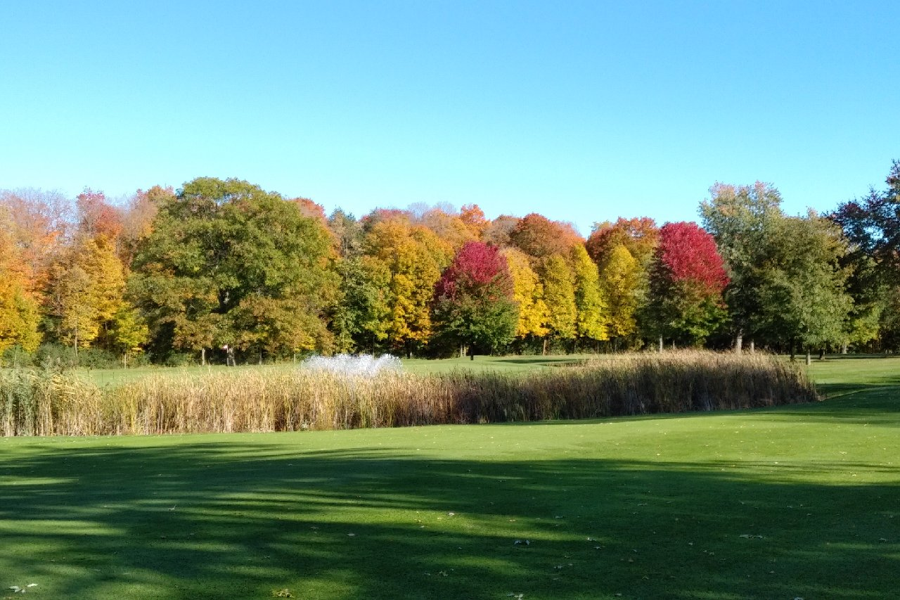
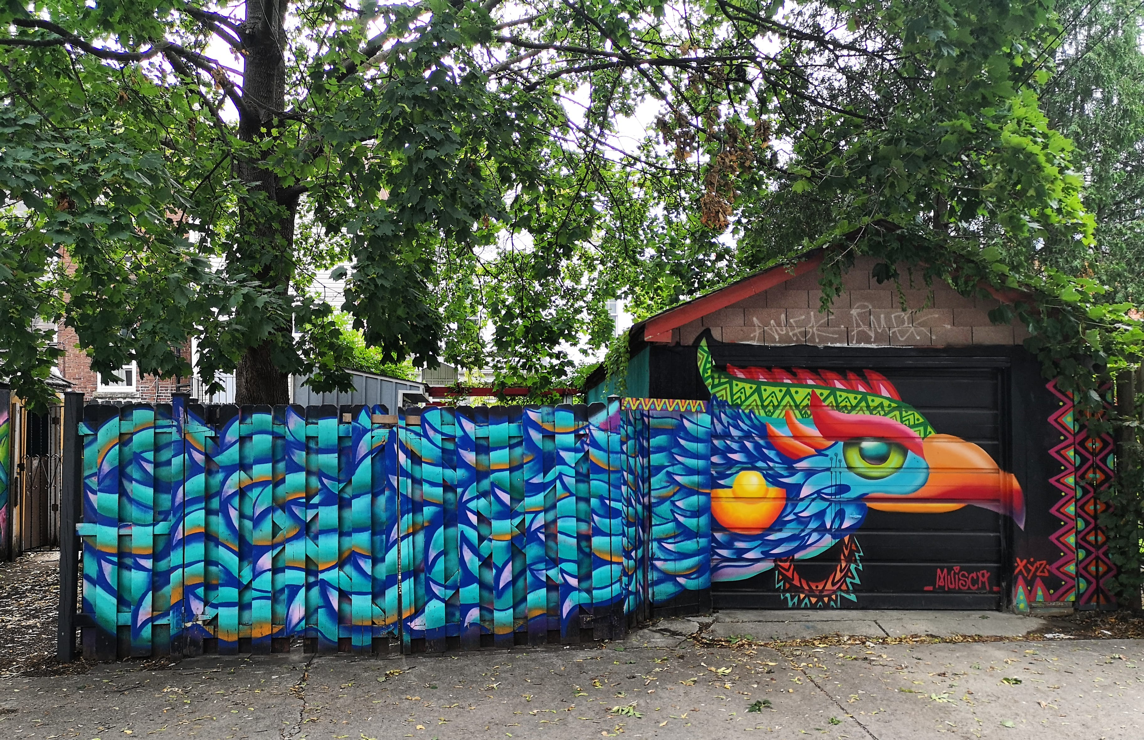
Beauty on all
the journeys
taken

Slide 14
Amazing workshops
lead by our volunteers,
wellness facilitators,
therapists and doctors.

Slide 15
Meditation & Yoga by Maxine Speck
Connection, Intimacy and Healthy Sexuality
after Cancer with Dr Rutledge & Dr. Gabriela llie
Exercise Class with Anne Di Menna
Zumba with Candy Dobbin
Laughter Yoga and Breathwork
with Deborah Peniuk

Slide 16
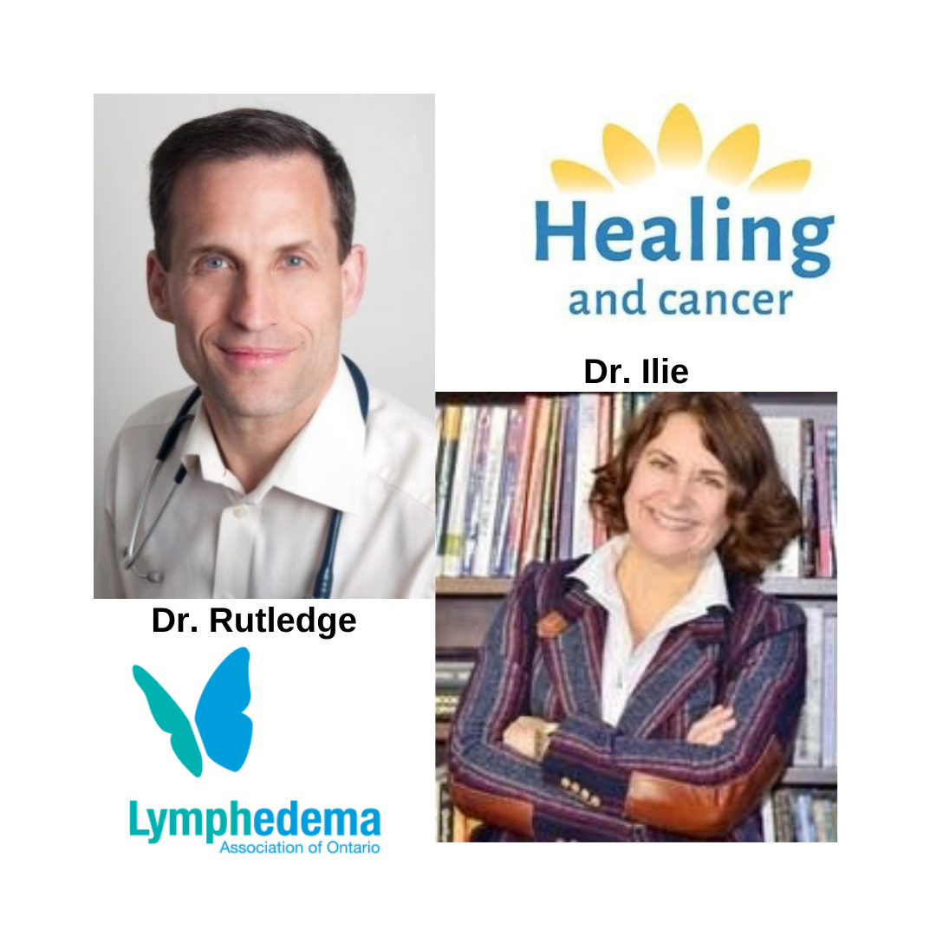

Slide 17
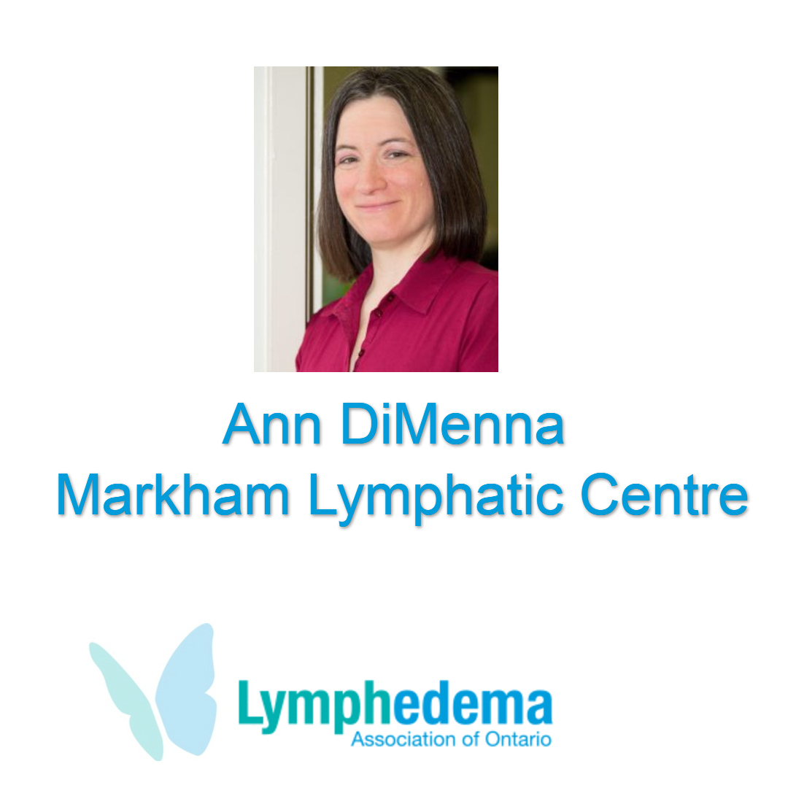
Deborah Peniuk
Certified Laughter Yoga Leader

Slide 18
“Dreams are made
if people try”
- Terry Fox

Slide 26
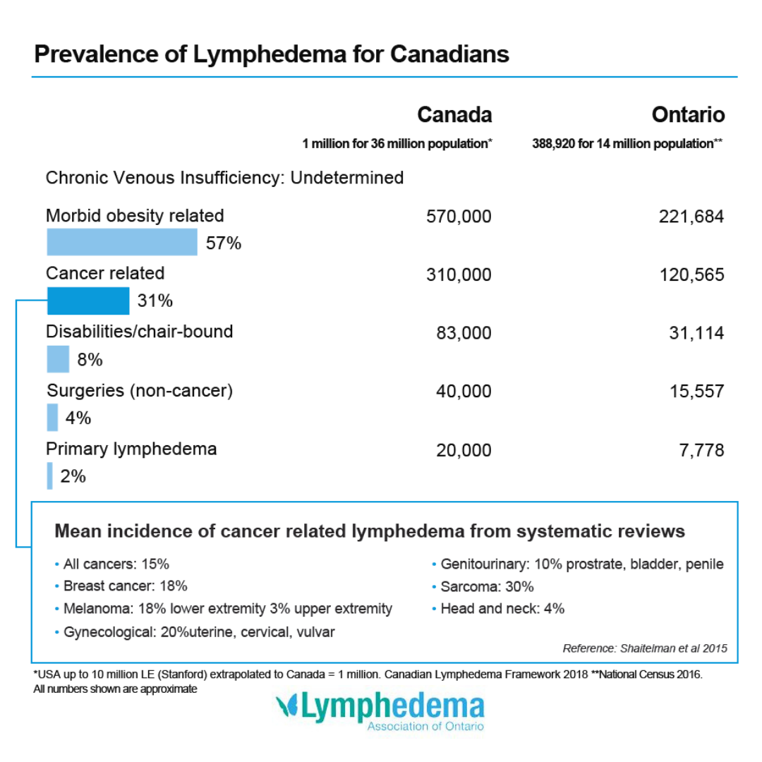

Slide 27
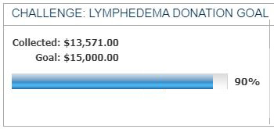
OUR FUNDRAISING GOAL
AND CURRENT COLLECTED TOTAL

Slide 28
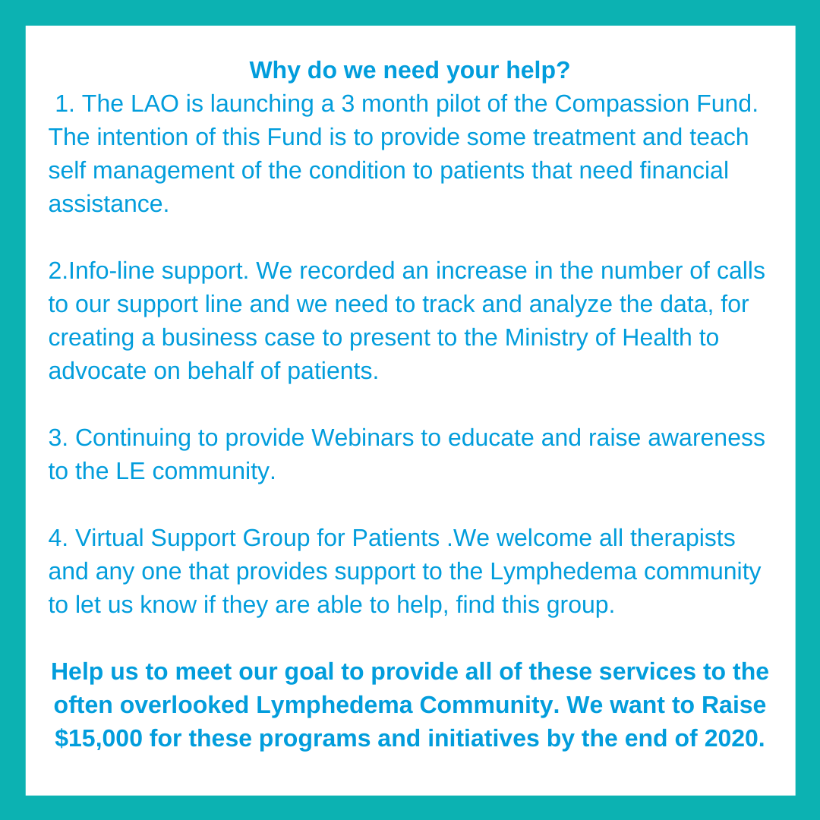

Slide 29
How you
can
continue to support

Slide 30
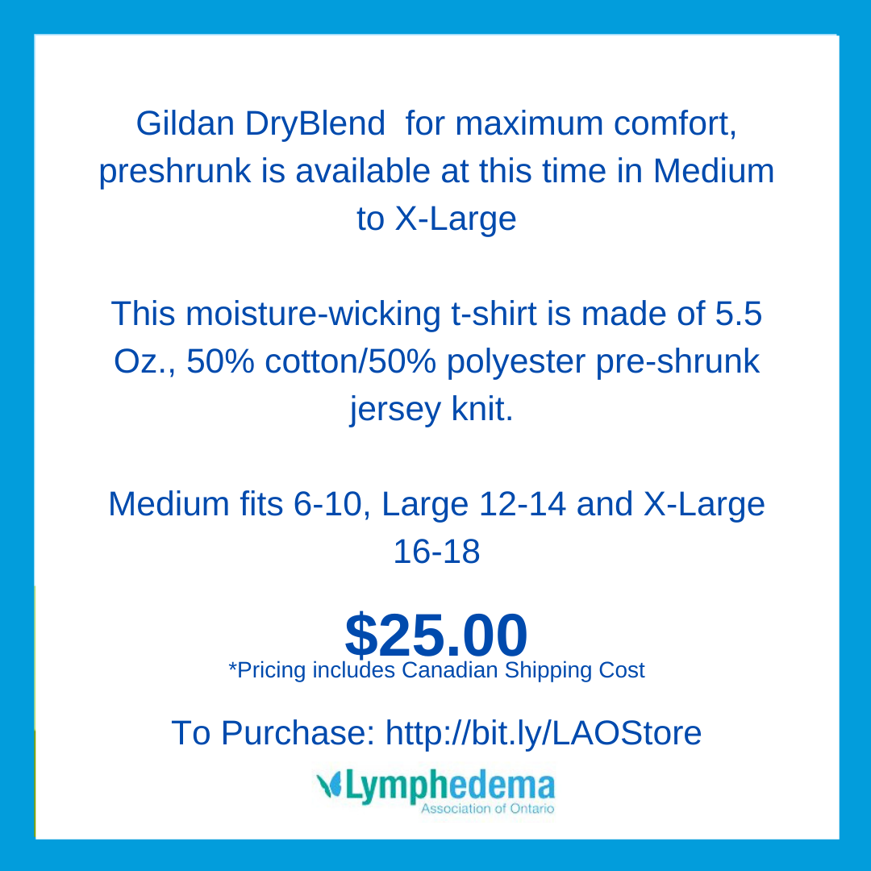

Slide 33
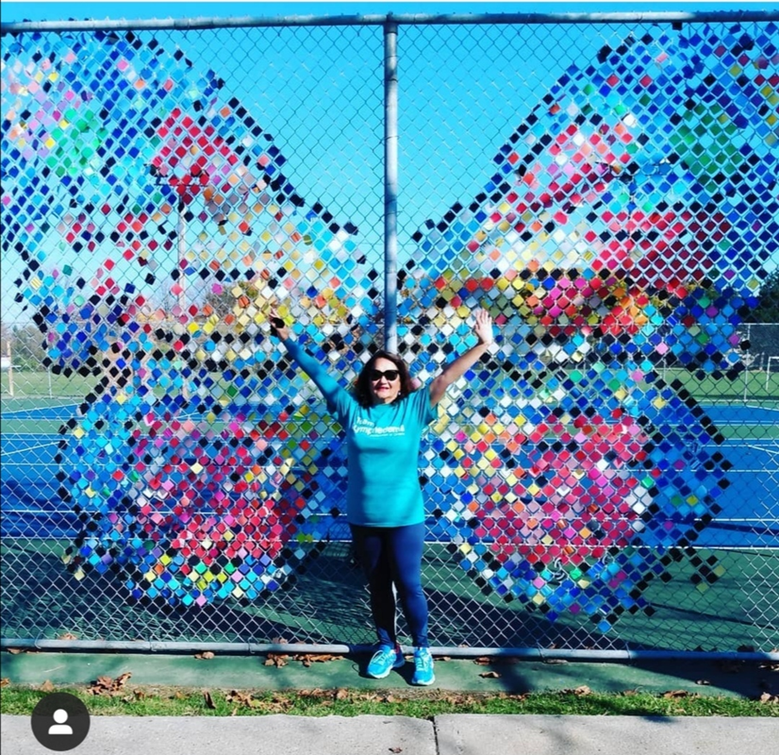
Thank you
for your efforts
during
CHALLENGE: LYMPHEDEMA
And your
continued support
of L.A.O.
www.Lymphontario.ca

Slide 34
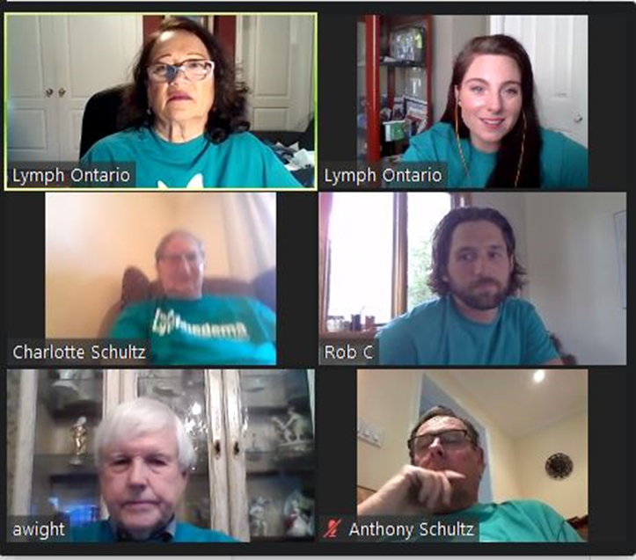
Big thanks to our featured participants –
Sara Quirling & family, Diane Lieder & family,
Sara Waddell, Dolores Steinwall, Jaclyn Jones,
Deborah Peniuk & Janet Vanderveen.
And our amazing Board Members & all of our volunteers!

